Slide 1
“Bridging the gap between education and employment to create a better INDUSTRY”
Education
Employment
Voice ideas
Discuss solutions
Propose actions

Slide 2
OUTREACH
INDUSTRY
EDUCATION
EMPLOYMENT

Slide 3
Break out rooms
EDUCATION
EMPLOYMENT

Slide 4
Break out rooms
What are some of the problems / barriers you are encountering in education / employment?
What are you doing well & want to share or celebrate with education / employment?
What one thing would you like to see education / employment start doing more of?

Slide 5
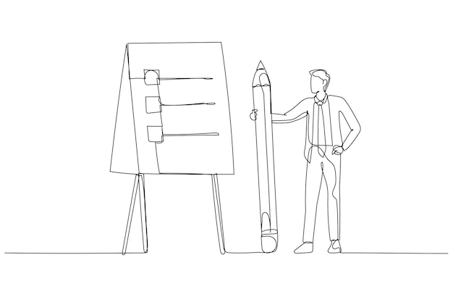
EDUCATION
What one thing do you
think employment needs to
know from education?

Slide 6
EDUCATION
What one thing would you like to see employment start doing more of?
Employers to think about care for early career workers
Wellbeing, work life balance, neurodiversity, career professional development
Visibility and collaboration from employment
Share placements, share contact details of tech staff, connect with your local uni / school etc. Add education links into business strategy
United goal on OUTREACH – attracting young people
Acknowledge FUNDING is a joint issue – work together
Share resources to help, loan equipment, offer support to employment for training development, lobby government and work together to find outreach funding

Slide 7
EDUCATION
What are some of the problems / barriers you are encountering in education?
Placements
STEAM” Science,technology, engineering, ARTS , Maths
Education and employment
having different goals
OUTREACH – attracting young people
Effecting recruitment on courses
Funding cuts
Parent & Student expectations are higher
Graduate destinations –
poor wages, work life balance, wellbeing, understanding the next generation are different from us

Slide 8
EMPLOYMENT
What one thing do you
think education needs to
know from employment?

Slide 9
EMPLOYMENT
What one thing would you like to see education start doing more of?
We need to do more for early outreach in schools / am drams
More collaboration with Education
Investment in supporting education / outreach for future business – not just social responsibility
More communication on employment skills
Managing expectation of early career roles
Normalising / celebrating crew roles

Slide 10
EMPLOYMENT
What are some of the problems / barriers you are encountering in employment?
Recruitment & retention
crisis
Graduate expectations
Skills gap / HOD roles
recruitment issue
Availability of students to
work in industry?
Graduates not ready
for employment roles
Do we know what is being
taught by education?

Slide 11
Expectation of Early Careers practitioners
2. Outreach / Awareness
3. Placements / Work experience
4. The goals of education
5. Funding
6. Recruiting & Training teachers

Slide 12
Desire for employment & education to work together more
Time and commitment from both sides
Invitation for each other to communicate and collaborate
People from employment & education to commit and work on some of the suggested actions
Supported by the ABTT
Join ABTT working groups or create new ones to continue discussions and actions
OUTREACH -

Slide 13
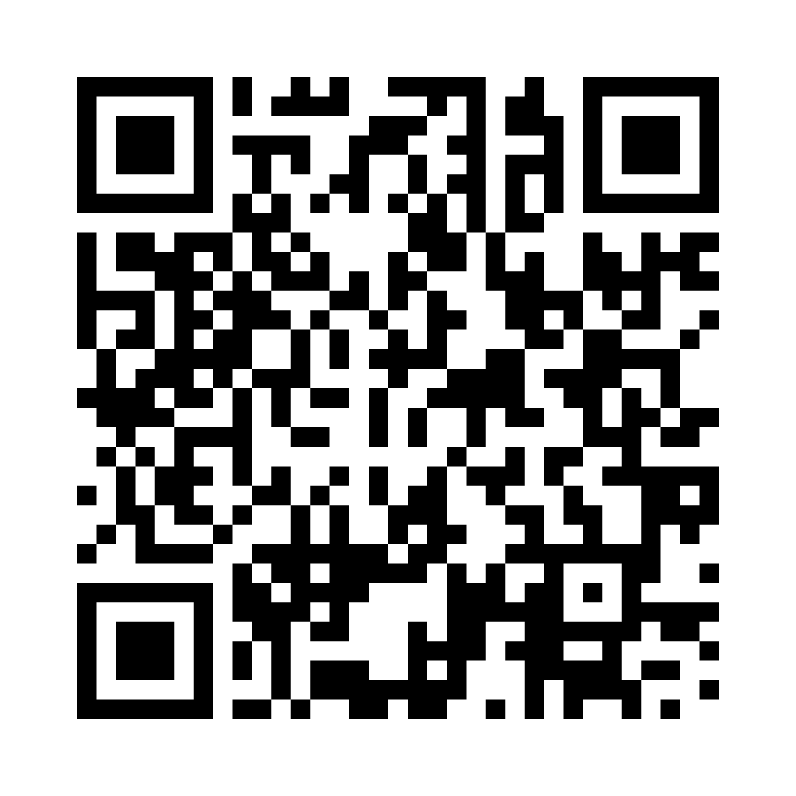
Group Rules:
1. Be Kind & Courteous
2. No Hate Speech or Bullying
3. No spam
4. Respect Everyone’s Privacy
5. Community Chats
Scan to join!

Slide 14
Action
Outreach and Visibility working Group
The ABTT Outreach & Visibility Working Group was established following the first Make a Difference Conference in 2023.
It sits under the Training and Education Committee.
The remit of the working group is to explore and implement strategies for bridging the gap between the theatre and events industry and the education sector through outreach work.

Slide 15
Action
The working group has 2 aims:
To develop and propose strategies for review by the Training and Education Committee that would increase the
ABTT’s outreach in relation to the promotion of production and technical career pathways to young people.
To implement the following outreach strategies in collaboration with the Training and Education Committee and ABTT staff members:
Developing a social media presence for production and technical roles
Developing a package for primary school workshops
Linking the technical creative industry to the wider curriculum
Defining work immersion opportunities

Slide 16
Action
If you are interested in finding out more about the working group, would like to get involved, or have an idea of other outreach strategies please contact Chris Stone
cstone@mulberryschoolstrust.org.

Slide 17
